Slide 1


Slide 2
UNIT-IV

Slide 3
Outline
Introduction
Sensor Definition
Use of Sensors
Sensor Network Definition and the Use of Sensor Networks
Traditional Sensor Networks vs. WSNs
Sensors Employed by CPS
Types of Sensors
Sensor Performance
Smart Sensors
Sensor Networks and Associated Technologies
Wireless Sensor Networks as Sensor Networks and Smart Sensor Networks
→ Wireless Network as Sensor Network
→ Smart Sensor Networks

Slide 4
Introduction
Sensor Definition and the Use of Sensors
Sensors are devices that measure physical quantities of the environment around them and convert these quantities into electrical/optical/sound-wave/mechanical signals, which can be read or viewed by an observer or by an instrument
The physical quantity can be a movement of a human body or movement of an object or environmental temperature or wind velocity or gun shots
In general, various sensor devices are typically used by Wireless Sensor Networks (WSNs) and Mobile ad-hoc Networks (MANETs) that construct a cyber-physical system (CPS) for monitoring the physical quantities specified by a user

Slide 5
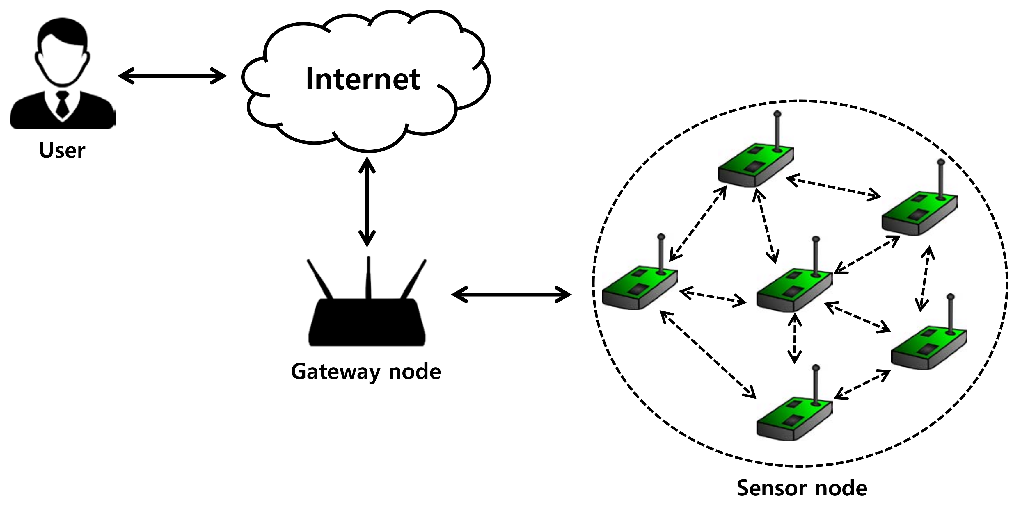
Introduction
Sensor Network Definition and the Use of Sensor Networks
Sensor networks are wired or wireless networks of sensors, which can collect and disseminate environmental data
WSNs have applications on modern and emerging CPSs, such as in health care, environmental and structural monitoring in smart cities, smart battle fields, cyber space tracking, borderlines, platform location determination, platform self-navigation, and gathering sensing information remotely in both hostile and friendly locations
Sensor networks employ the various types of sensor in their general-purpose design approach that provides services to many aforementioned applications
Traditionally, the networks usually consist of a number of sensor nodes that are wired or wirelessly connected to a central processing station

Slide 6
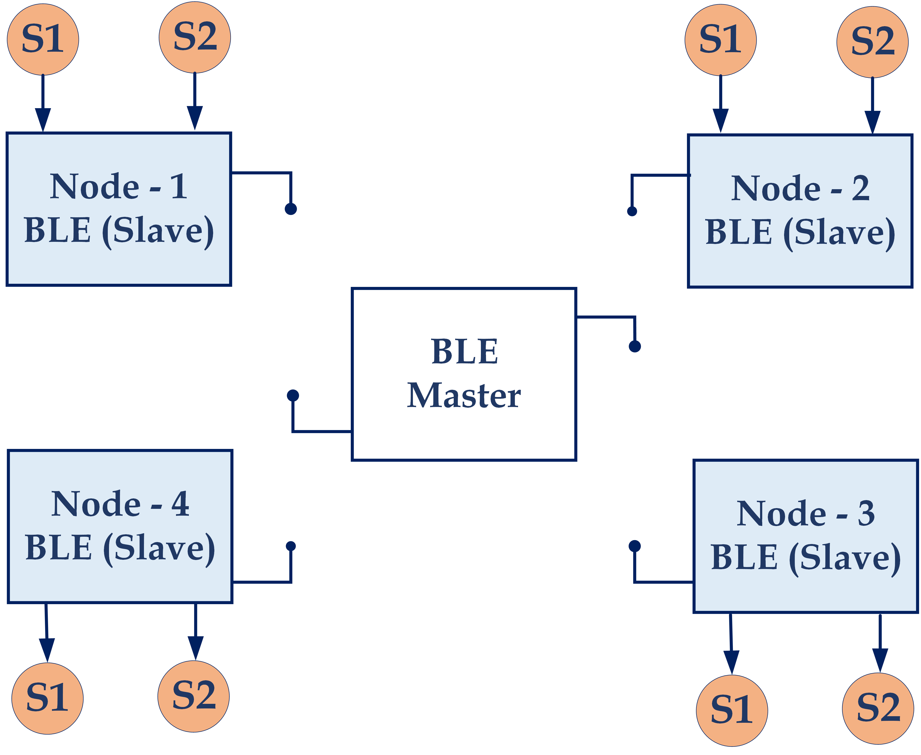
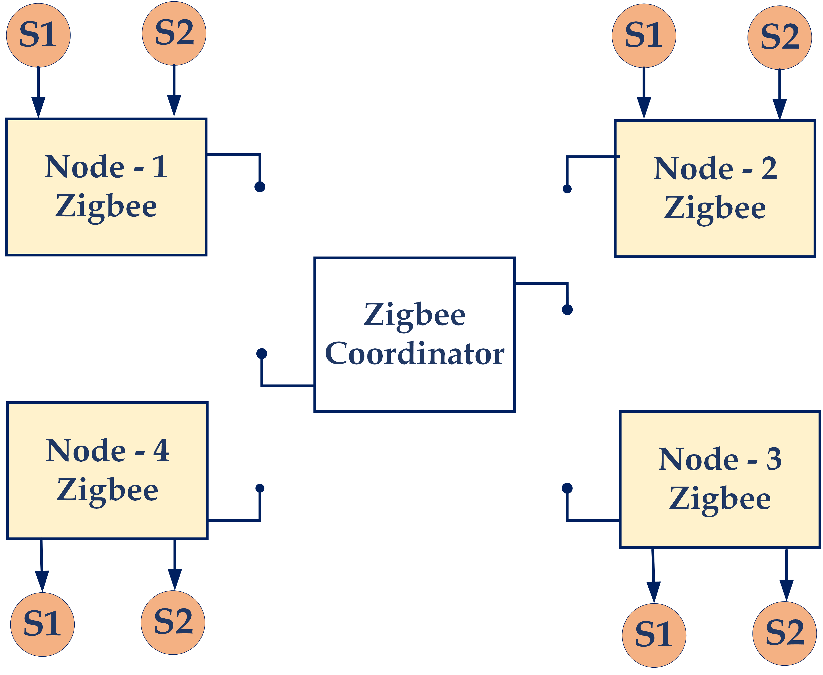


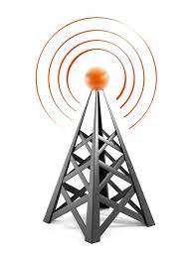


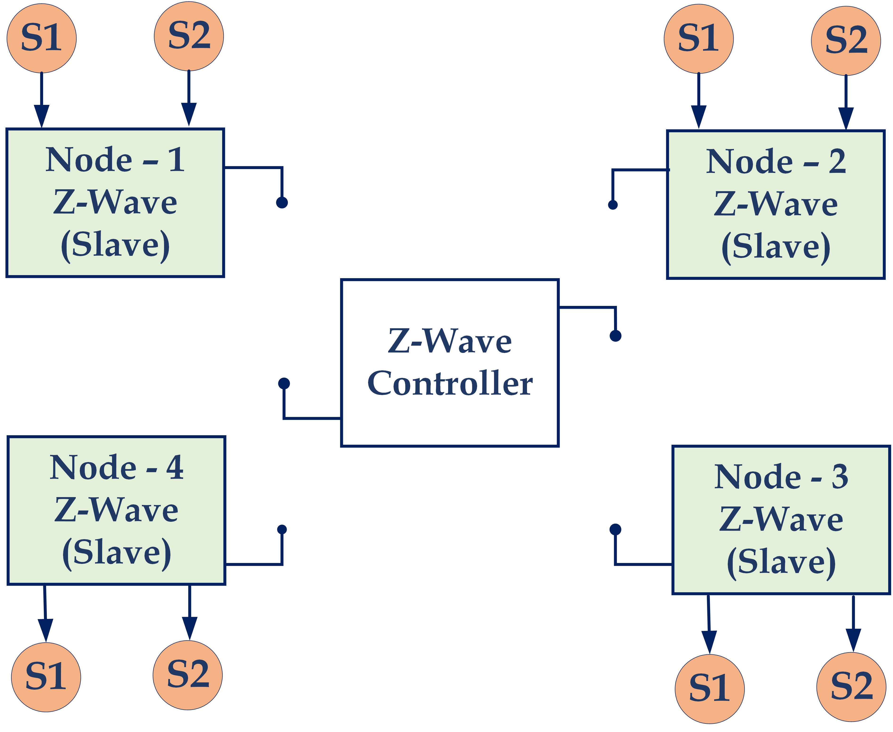
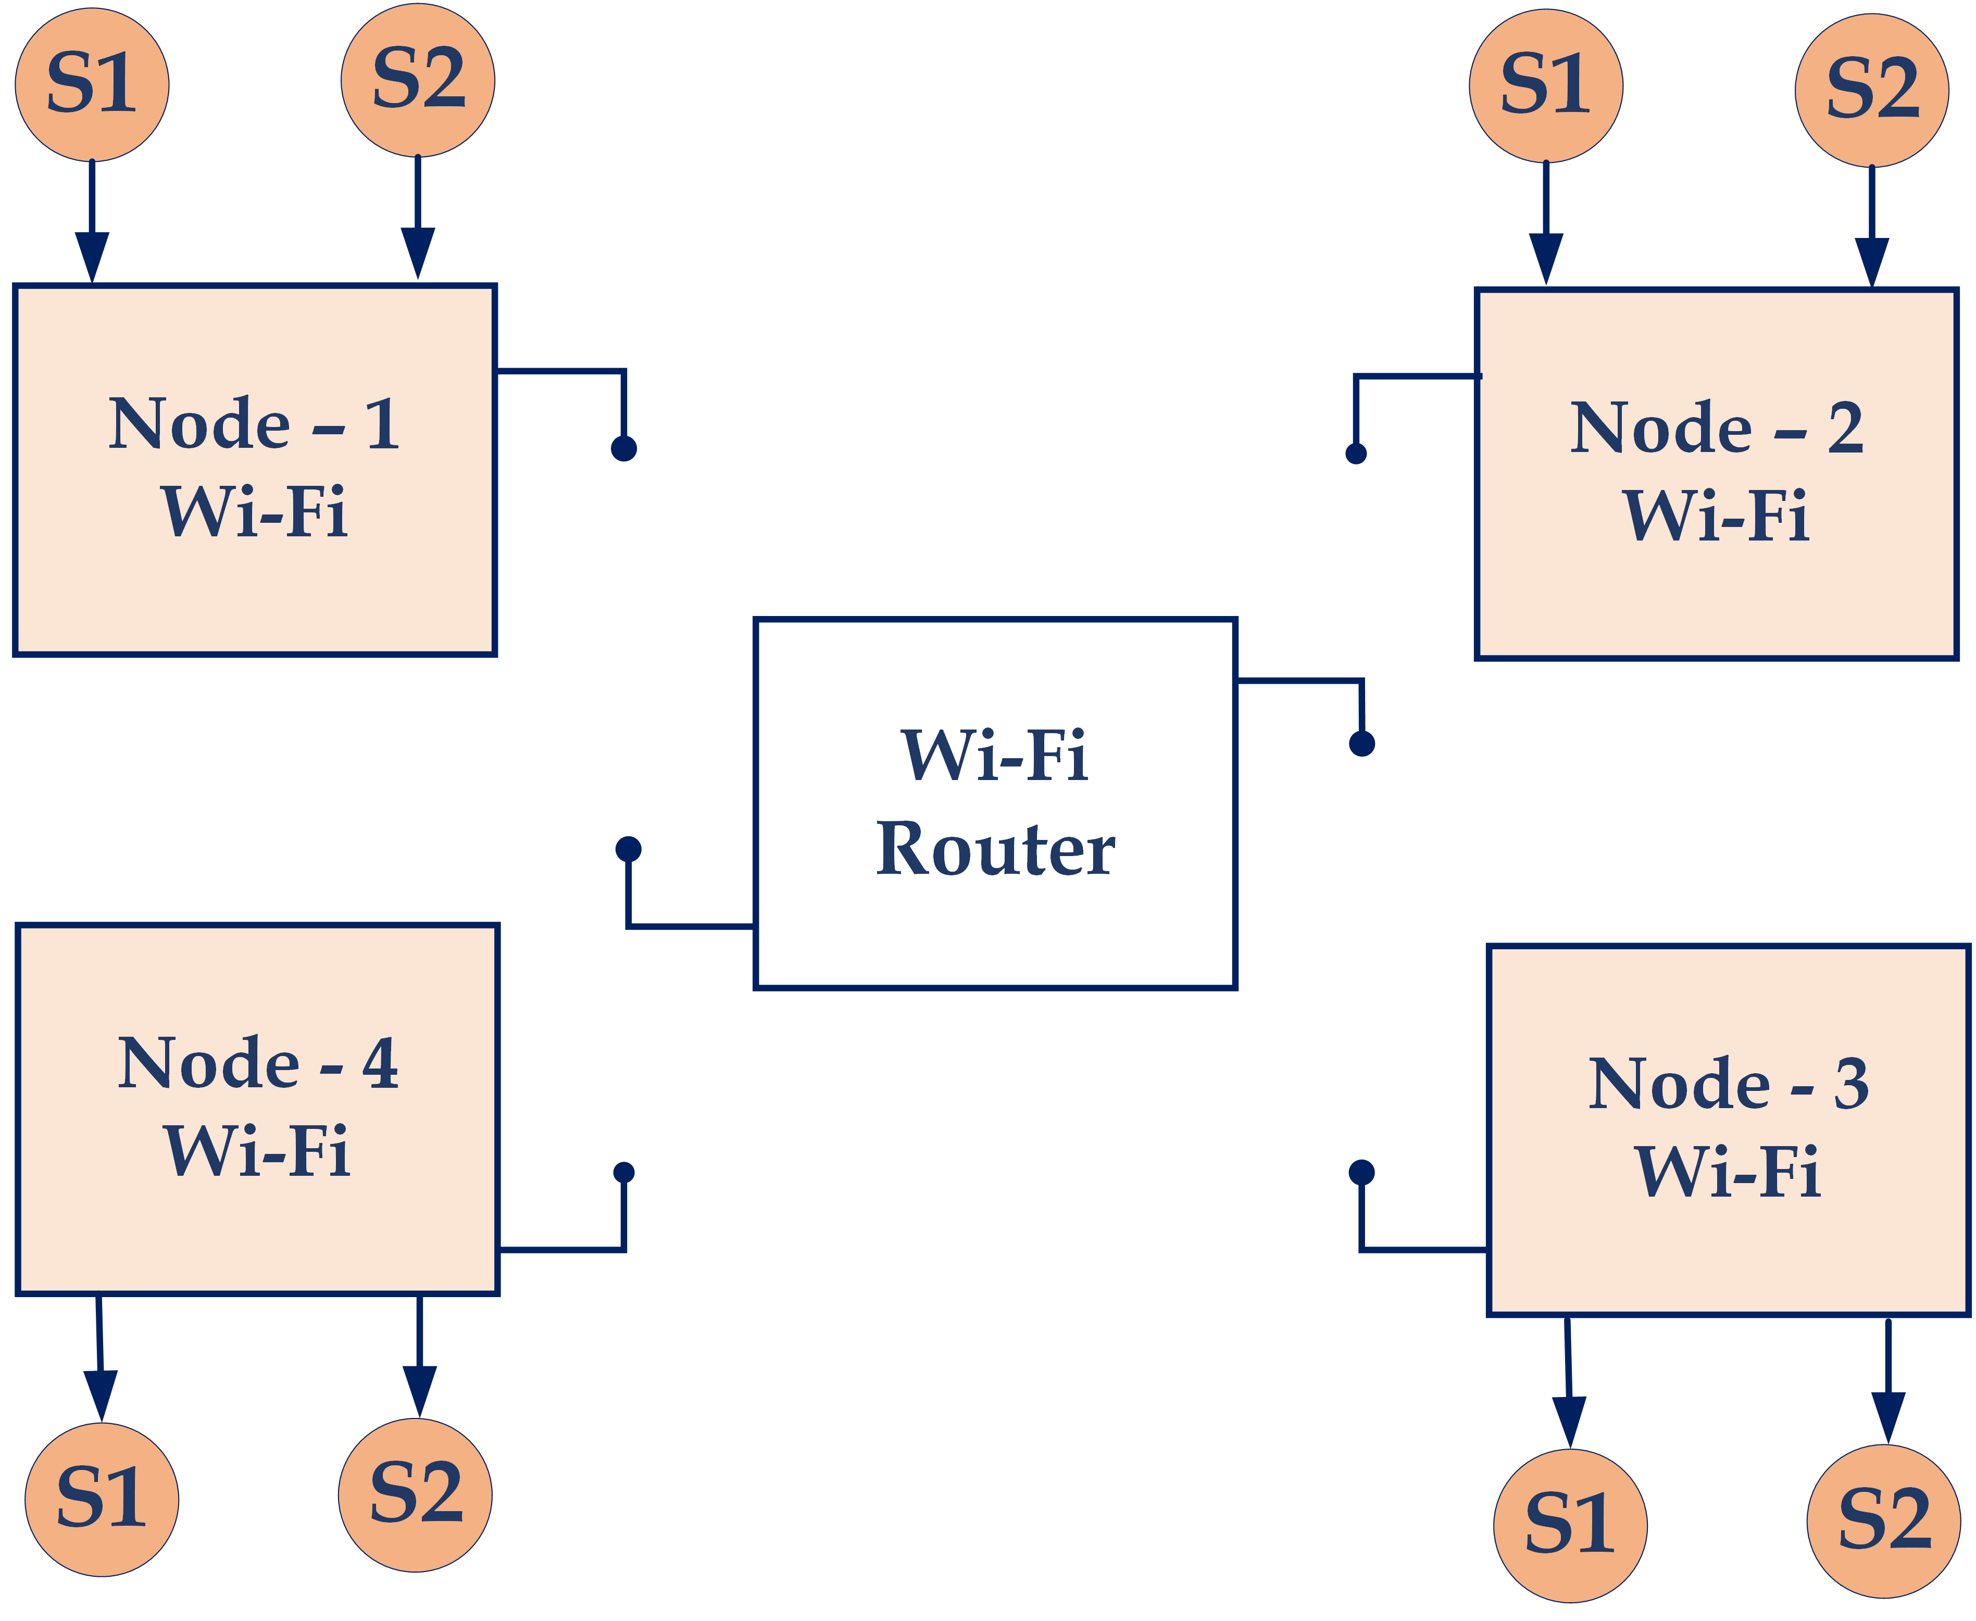
Environment
Cluster-1
Cluster-3
Node-1
Node-2
Node-1
Node-2
Co-Ordinator
Co-Ordinator
Node-4
CH
Node-3
Node-4
CH
Node-3
Processing
Cloud
Node-1
CH
Node-2
Base Station/ Sink
Node-1
CH
Node-2
Co-Ordinator
Co-Ordinator
Node-4
Node-3
Node-4
Node-3
Cluster-2
Cluster-4

Slide 7
Introduction
Sensor Network Definition and the Use of Sensor Networks
The primary design concerns for traditional sensor networks are
Network Performance
Latencies
WSNs usually consist of a dense number of sensor nodes and each sensor node is capable of only a limited amount of processing
Primary design concerns for WSN’s are
Power Consumption
Communication Cost
CPSs uses WSN’s – it is a large collection of sensor nodes, which are working together in a coordinated manner to perform some specific action, such as movement monitoring in a remote area

Slide 8
Introduction
Sensor Network Definition and the Use of Sensor Networks
Presently, the researchers on sensor networking focus more on wireless, distributed, mobile sensing nodes for CPS applications when the exact location of a particular phenomenon is not known, thus distributed and mobile sensing allows for closer placement to the phenomenon than a single sensor would permit
For wireless sensing applications on CPSs, the environment to be monitored usually does not have an existing infrastructure for either power or communications

Slide 9
Sensors Employed by CPS
Types of Sensor
In general, sensors used by CPSs can be classified into 14 sensing types
Acoustic, sound, and vibration
Automotive and transportation
Chemical
Electric, magnetic, and radio
Environment, weather, moisture, and humidity
Flow and Fluid velocity
Ionizing radiation and subatomic particles
Navigation instruments
Position, angle, displacement, distance, speed, and acceleration
Optical, light, and imaging pressure
Force, density, and level
Thermal, heat, and temperature; and
Proximity and presence

Slide 10
Sensors Employed by CPS (Contd.)
Types of Sensor
Acoustic, sound, and vibration sensors include microphone, geophone, seismometer, and accelerator
Automotive and transportation sensors are speedometer, map sensor, water sensor, parking sensor, and video sensor
Chemical sensors consist of sensing carbon, gas, hydrogen, oxygen, and smoke
Electric, magnetic, and radio sensors are magnetometer, metal detector, and telescope
Environment, weather, moisture, and humidity sensors are leaf sensor, rain/snow gauge, and pyranometer
Flow and Fluid velocity sensors are air Flow meter, Flow sensor, and water meter
Ionizing radiation and subatomic particles sensors include neutron detection, and particle detector
Navigation instruments sensors are air speed indicator, depth gauge, gyroscope, and turn coordinate

Slide 11
Sensors Employed by CPS (Contd.)
Types of Sensor
Position, angle, displacement, distance, speed, and acceleration sensors are accelerometer, position sensor, tilt sensor, and ultrasonic sensor
Optical, light, and imaging sensors consist of colorimeter, electro-optical sensor, infrared sensor, and photodiode
Pressure sensor includes barometer, boost gauge, pressure gauge, and tactile sensor
Force, density, and level sensors are force gauge, level sensor, load cell, and hydrometer
Thermal, heat, and temperature sensors are heat sensor, radiometer, thermometer, and thermistor
Proximity and presence sensors include motion detector, occupancy sensor, and touch switch

Slide 12
Sensors Employed by CPS (Contd.)
Sensor Performance
Sensor performance can be characterized by the
The range of values, from minimum to maximum value, that it can measure
The measurement resolution, which is the smallest noticeable change in the measured value
Sensor linearity or maximum deviation from a “straight-line” response
Sensor sensitivity or a measure of the change at the sensor output for a given change of sensor input
Sensor accuracy or sensor precision or a measure of the difference between measured and actual values
A sensor network designer selects the sensors based on their performances to meet a specific requirement in designing a sensor network

Slide 13
Sensors Employed by CPS (Contd.)
Smart Sensor
Smart sensors are currently employed by many contemporary CPS
There are several definitions for smart sensors that basically describe a sensor that is capable of processing, manipulation, and computation of the sensor-derived data
To perform “processing–manipulation–computation,” the smart sensor requires interfacing circuit, logic functions, two-way communication device, and decision-making device
Three-key components of the smart sensor in action/reaction loop including Observe, Analyze-Make Decision, and Act
The “Act” is connected to the “Observe” component by a “Process” that is provided as a Human-In-The-Loop (HITL) or an automated process
The smart sensor definition is illustrated in Figure
It follows the OODA (Observe, Orient, Decide, and Act) loop developed by a military strategist and USAF Col. John Boyd.

Slide 14
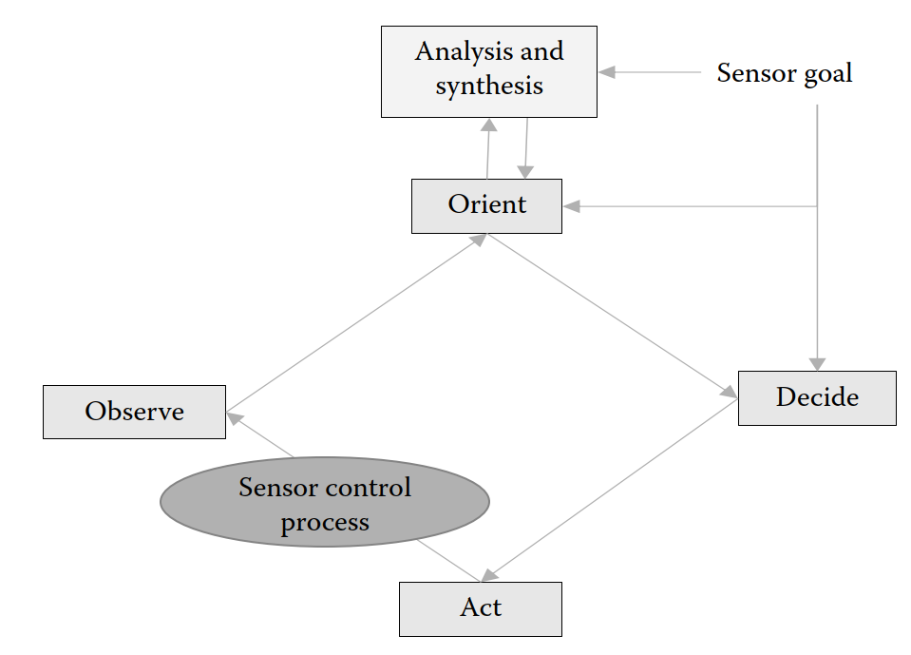
Sensors Employed by CPS (Contd.)
The smart sensor is defined as the one that acts based on the “sensor goal” and “sensor control process.”
“Sensor goal” controls the “Orient” and “Decide” components through the “Analysis & Synthesis” process
The “Act” and Observe” components are controlled by the “Decide” component and “sensor control process, respectively”
Figure. Definition of smart sensor using OODA loop for modern CPSs

Slide 15
Sensors Employed by CPS (Contd.)
Smart Sensor
A smart sensor that employs the process shown in Figure should include at least three baseline hardware/software components, including Sensor Networking Processor (SNP), Sensor Interface Module (SIM), and Sensor Control Processor (SCP)
Basic SNP functions include two-way communication, message routing, message encoding and decoding, discover and control, and data correction interpretation
Basic SIM functions are storage, Analog Signal Conditioner (ASC), Analog-to-Digital Converter (ADC), trigger, command processor, data transfer, and two-way communication
SCP functions consist of sensor resource management and associated sensing control requirements to meet the sensor goal
Examples of smart sensors are accelerometers, optical angle encoders, optical arrays, infrared detector array, integrated multi-sensor, structural monitoring, and geological mapping
Applications of smart sensors include but are not limited to smart homes, smart cities, intelligent building, predictive maintenance, health care, industrial automation, energy saving, and defense

Slide 16
Sensors Employed by CPS (Contd.)
Sensor Products
Presently, there are many types of sensor products available in the market
Examples of existing state-of-the-art sensor products are produced by Omoron Industrial Automation, Keyence Inductive Proximity Sensors, Pressure Profile Systems (PPS)
Harry G Security, Fujifilm Optical Devices for interferometer, Baumer Sensor Products for presence detection/distant measurement/angle measurement/process instrumentation/ identification image processing, System Sensor for life and safety, SICK Sensor Intelligence for industrial sensors, Analog Devices for MEMS Accelerators/Gyroscopes/Internal Measurement Units (IMU)/Inertial sensors/Temperature sensors, Samsung for CMOS Image sensors, ST Life Augmented for MEMS Accelerometers/Gyroscopes/Digital Compasses/Pressure sensors/Humidity sensors and microphones/ smart sensors/sensor hubs/temperature sensors/touch sensors, Linear Technology for wireless sensor networking
Honeywell Aerospace for magneto-resistive sensors, and GE Measurement & Control for MEMS Pressure sensors

Slide 17
Sensor Networks and Associated Technologies for CPS Applications
WSNs—A Traditional Centralized Sensor Networking Approach
The Traditional Centralized Sensor Network (TCSN) is a general-purpose design using centralized network management approach, which intends to serve many applications
The TCSNs are designed and built according to detailed plans with primary design concerns focused on sensor network performance and latencies that aligned with a required operational plan in a controlled environment
The Control Environment allows for easy access to sensor repair and maintenance with component failure and maintenance are addressed through sensor maintenance and repair plans
An example of TCSN is a sensor network for a plastic bottle manufacturing product line, where sensors are used to monitor temperature, pressure, and counting the bottles for making the bottles and packaging the bottles, respectively
As opposed to TCSN, WSN is usually used for CPS applications, which is a single-purpose design using distributed network management to serve a specific application where power is the key design constraint for all sensor nodes and network components

Slide 18
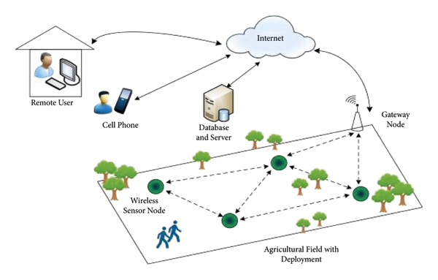
Sensor Networks and Associated Technologies for CPS Applications (Contd.)
WSNs—A Traditional Centralized Sensor Networking Approach
N3
N1
N4
N2

Slide 19
Sensor Networks and Associated Technologies for CPS Applications (Contd.)
WSNs—A Traditional Centralized Sensor Networking Approach
WSN deployment for a CPS is often ad hoc without planning, and it usually operates in an environment with harsh conditions with very difficult physical access to sensor nodes
Unlike TCSN, WSN component failure is addressed through the design of the network

Slide 20
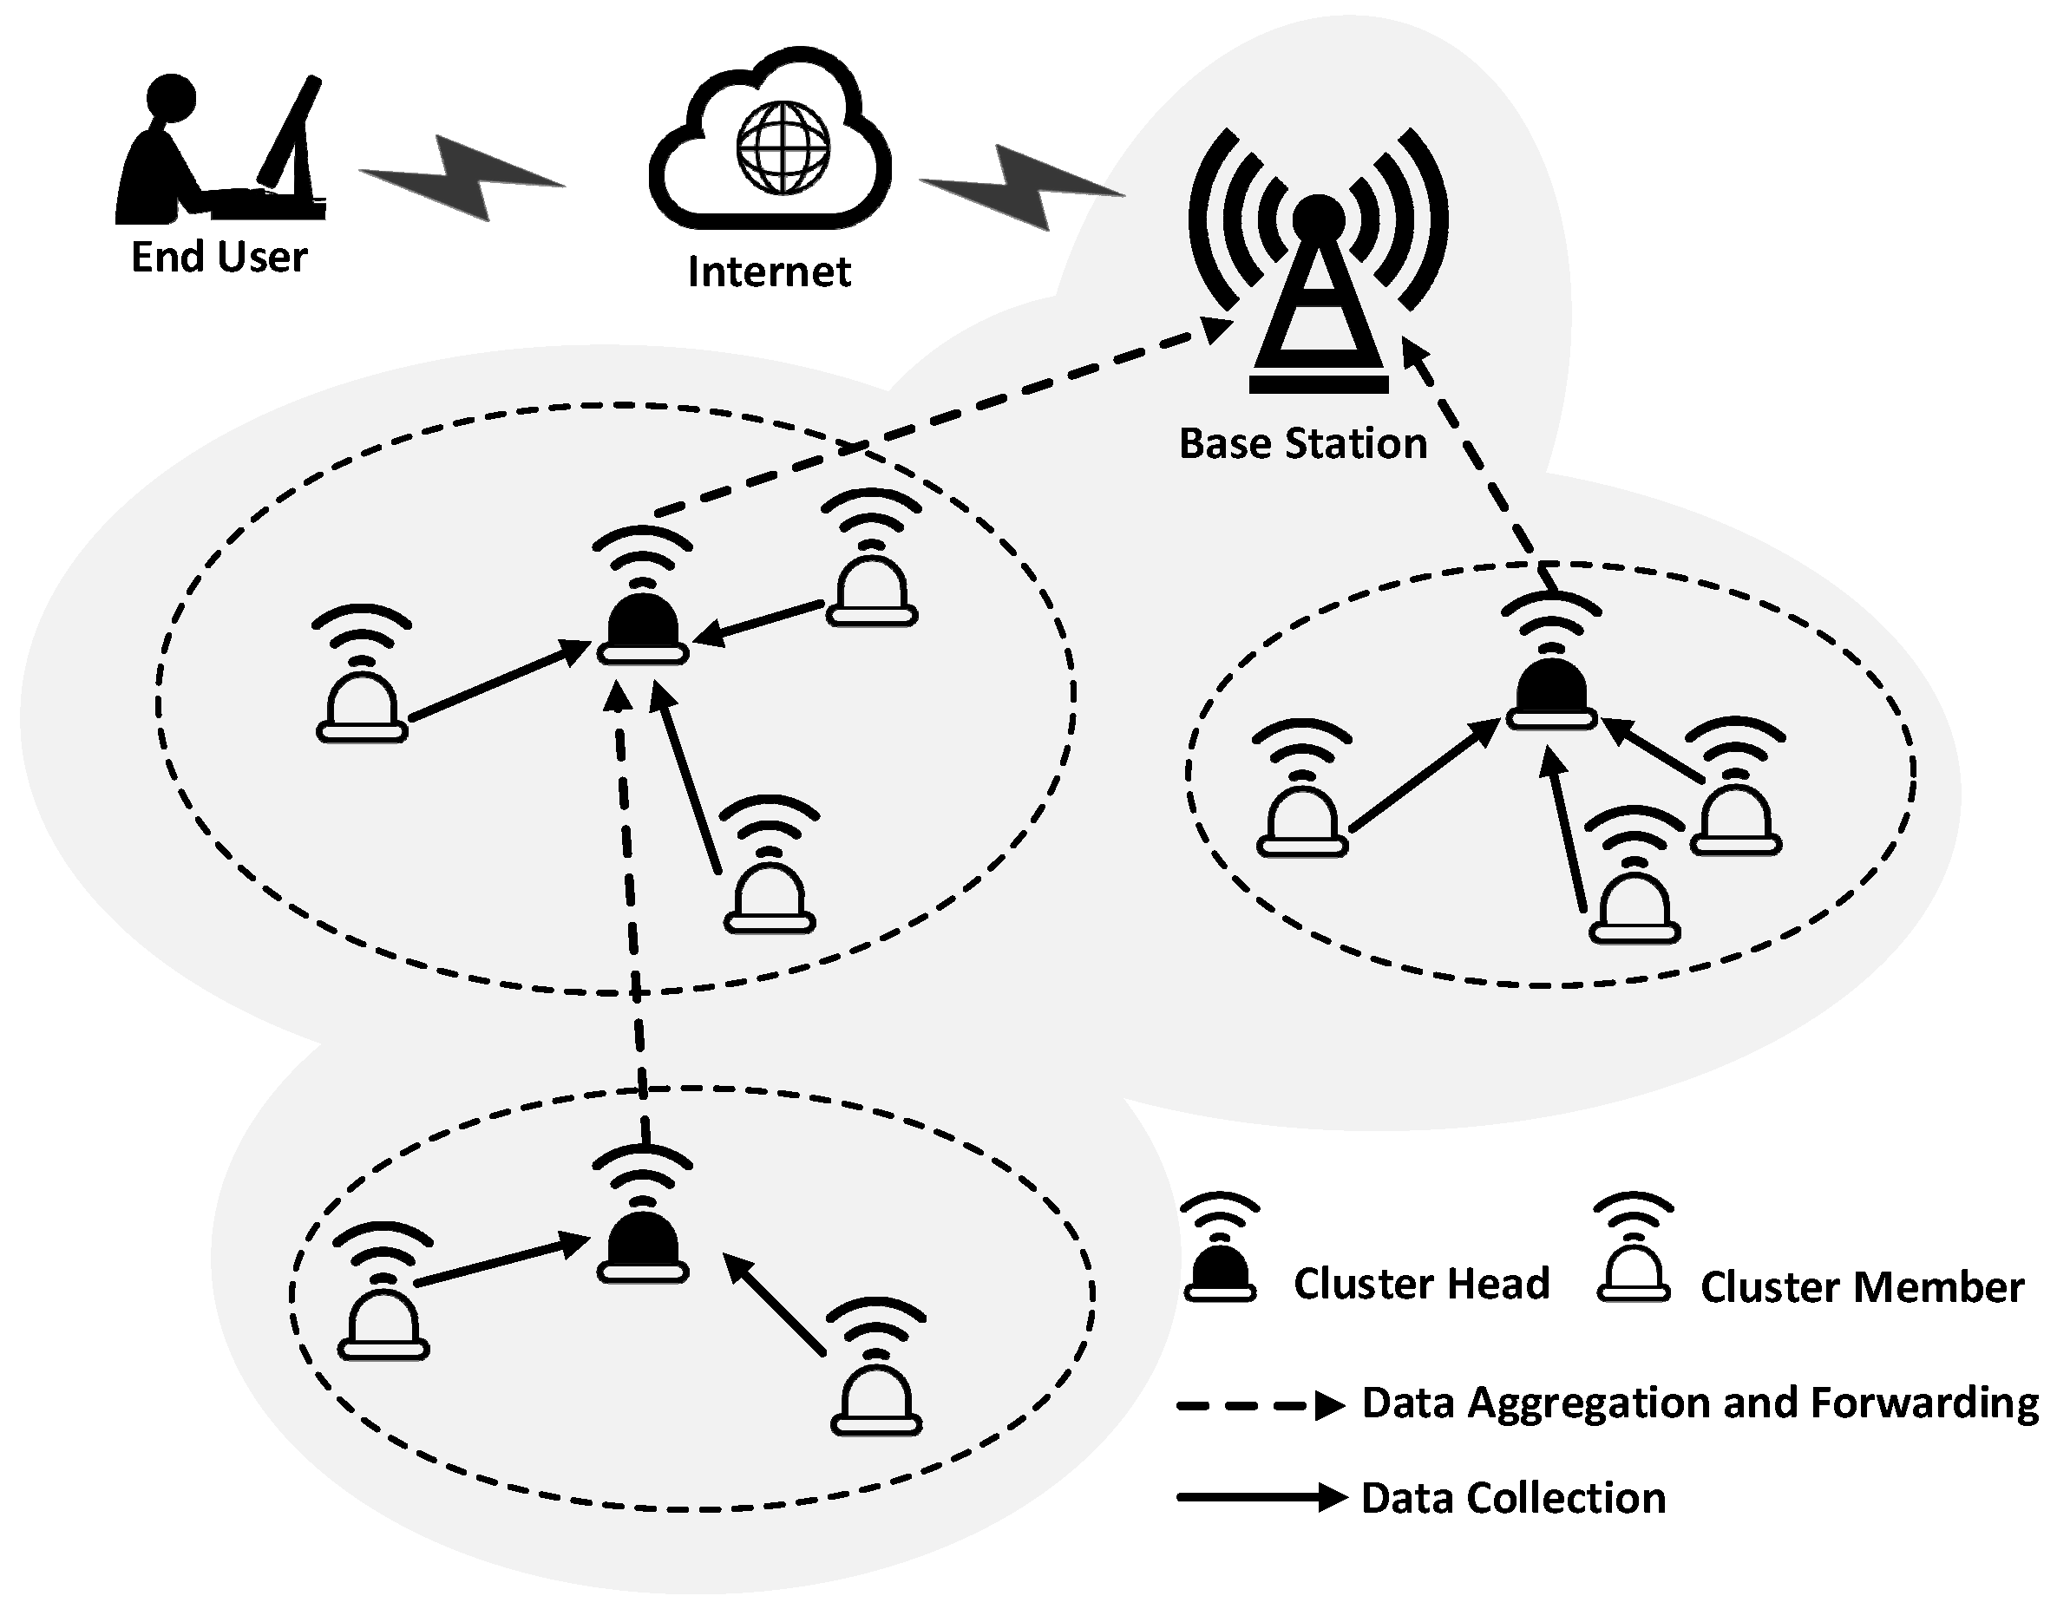
Sensor Networks and Associated Technologies for CPS Applications (Contd.)
Distributed WSNs
Emerging CPSs employ MANET and distributed WSNs for collecting sensing data to gain knowledge on the activities of interest to users
MANET and distributed WSNs that are currently used by emergent CPSs, including intelligent health-care cyber system, intelligent rescue cyber system, intelligent transportation cyber systems, and intelligent social networking cyber system

Slide 21
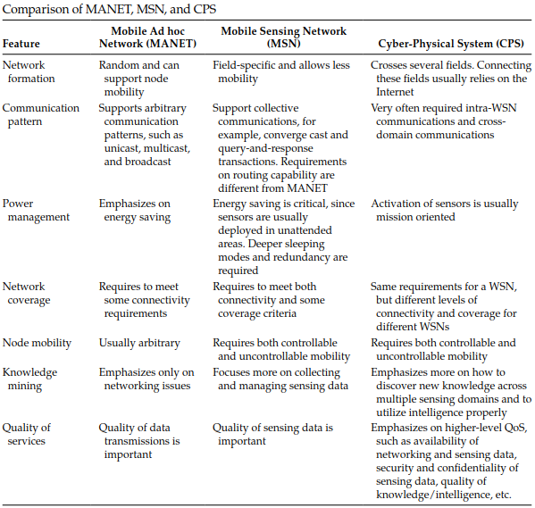
Sensor Networks and Associated Technologies for CPS Applications (Contd.)

Slide 22
Sensor Networks and Associated Technologies for CPS Applications (Contd.)
Compressive Wireless Sensing Network
Recently, Compressive Wireless Sensing Network (CWSN) has been developed based on Compressive Sensing (CS) technology, which is a novel sampling technique to reduce the minimum samples required to reconstruct a signal by exploiting its compressibility property
CS technology allows for less communication bandwidth, sensor processing, and power requirements imposed on the CWSN design and deployment
The key features of CWSN are:
Processing and Communications—they are combined into one distributed operation, without or very little in-network processing and communications, and
Consistent Field Estimation is possible even if little or no prior knowledge about the sensed data, while the total power required for the CWSN grows at most sub-linearly with the number of nodes in the network

Slide 23
Sensor Networks and Associated Technologies for CPS Applications (Contd.)
IP-Based Sensor Network
IP-based sensor network (IP-BSN) allows the networks in a CPS to cross several sensor fields and connect these elds by Internet
The emergence of the IETF 6LoWPAN* (RFC 4944) standard for IP communication over low-power radio has made the design and implementation of IP-BSN a reality
This network uses IETF 6LoWPAN adaptation layer that carries IPv6 addresses in a compact form using small IEEE 802.15.4 short addresses

Slide 24
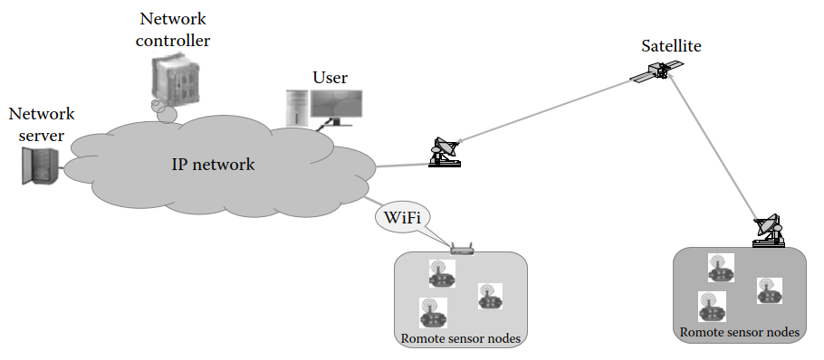
Sensor Networks and Associated Technologies for CPS Applications (Contd.)
IP-Based Sensor Network
Figure. Example of an IP-based Sensor network (IP-BSN)

Slide 25
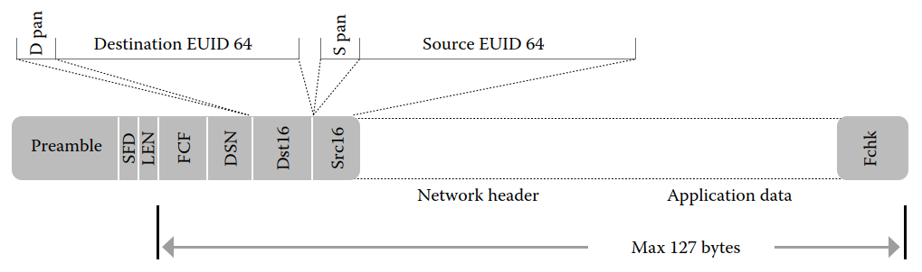
Sensor Networks and Associated Technologies for CPS Applications (Contd.)
IP-Based Sensor Network
This network supports a variety of IP links while understanding the links, characteristics through the use of abstraction layer. A packet frame format using IEEE 802.15.4 standard is described in the below Figure
IEEE 802.15.4 Standard Packet Frame Format

Slide 26
Sensor Networks and Associated Technologies for CPS Applications (Contd.)
Dynamic Spectrum Access (DSA) Sensing Networks
DSA Sensing Network (DSA-SN) consists of a set of wireless sensor nodes that are placed in a specified location for monitoring the RF (Radio Frequency) environment of interest.
The purpose of DSA-SN is to perform spectrum sensing and detect unused spectrum for sharing the spectrum without harmful interference among users.
A survey of the spectrum sensing techniques is provided in Table.
The use of DSA-SN allows a CPS to achieve the same network coverage as typical WSNs but at different levels of connectivity and coverage for different WSNs.
The IP-BSN with a CS-based technique can be used in the design and implementation of a DSA-SN
DSA-SN is usually employed by a Cognitive Radio (CR) wireless network for frequency and bandwidth scheduling among coexisting network users

Slide 27
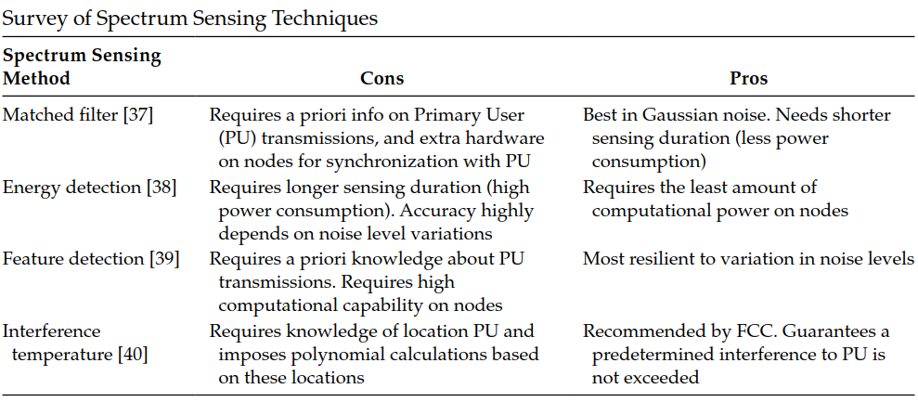
Sensor Networks and Associated Technologies for CPS Applications (Contd.)
Dynamic Spectrum Access (DSA) Sensing Networks

Slide 28
Sensor Networks and Associated Technologies for CPS Applications (Contd.)
Cognitive Radios (CR) Sensing Networks
CR Sensing Network (CRSN) adopts the CR capability in sensor networks
WSN comprises a number of sensor nodes equipped with CR that are likely to benefit from the potential advantages of the DSA features, such as
(1) opportunistic channel usage for bursty traffic,
(2) DSA,
(3) using adaptability to reduce power consumption,
(4) overlaid deployment of multiple concurrent WSN, and
(5) access to multiple channels to conform to different spectrum regulations
In general, CRSN can be defined as “a distributed network of wireless cognitive radio sensor nodes, which sense an event signal and collaboratively communicate their readings dynamically over available spectrum bands in a multi-hop manner ultimately to satisfy the application-specific requirements.”

Slide 29
Sensor Networks and Associated Technologies for CPS Applications (Contd.)
Cognitive Radios (CR) Sensing Networks
CRSN applications can be classified into four categories:
Indoor Sensing: Tele-medicine, home monitoring, emergency networks, and factory automation.
Multimedia Sensing: Video, still image, audio
Multi-class Heterogeneous Sensing: Information is gathered through several WSNs and fused to feed a single decision support
Real-time Surveillance Sensing: Military surveillance for target detection and tracking
CRSN requires complex Dynamic Spectrum Management (DSM) framework to regulate the spectrum access for the deployed wireless sensor nodes
The framework includes three key components, namely, Spectrum Sensing Component (SSC) (see Table 1.2), Spectrum Decision Component (SDC), and Spectrum Hand-off Component (SHC)

Slide 30
Sensor Networks and Associated Technologies for CPS Applications (Contd.)
Cognitive Radios (CR) Sensing Networks
A communication framework is required to support the DSM. The communication framework consists of Physical Layer (PL), Data Link Layer (DL2), Network Layer (NL), Transport Layer (TL), and Application Layer (AL)
For CRSN, the design of Medium Access Control (MAC) within the DL2 to support wireless sensor nodes with access to medium in a fair and efficient manner is essential for minimum network latency. Table summarizes MAC design approach for CRSN
Emerging CPSs employ CRSN to allow for intra-WSN communications and cross-domain communications with emphasis on higher-level QoS, such as availability of net-working and sensing data

Slide 31
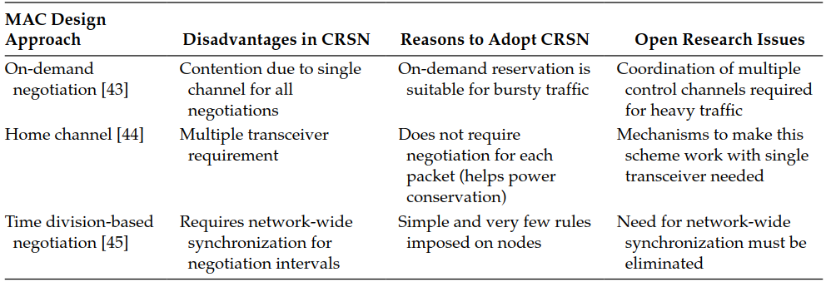
Sensor Networks and Associated Technologies for CPS Applications (Contd.)
Cognitive Radios (CR) Sensing Networks

Slide 32
Sensor Networks and Associated Technologies for CPS Applications (Contd.)
Wireless Networks as Sensor Networks
Extracting information from the variation in the strength of received signal from a wireless network can turn a wireless network into a sensor network
This type of sensor network is also referred to as Wireless Network as Sensor Network (WNaSN)
The Received Signal Strength Indicator (RSSI) provided by a wireless network can be used for localization by position determination, motion detection, and velocity estimation of the wireless radio nodes in the network or position and motion of bodies external to the network
The RSSI-based WNaSN can be divided into active and passive localization
Active localization is the practice of locating a person or asset that is carrying an RF device, such as Personal Communications Service (PCS) device or RF tag
Passive localization does not require the person or asset to carry any electronic device, sensor, or tag. The WNaSN employs passive localization, which is referred to as Device-Free Localization (DFL) or RF Tomography (RFT)

Slide 33
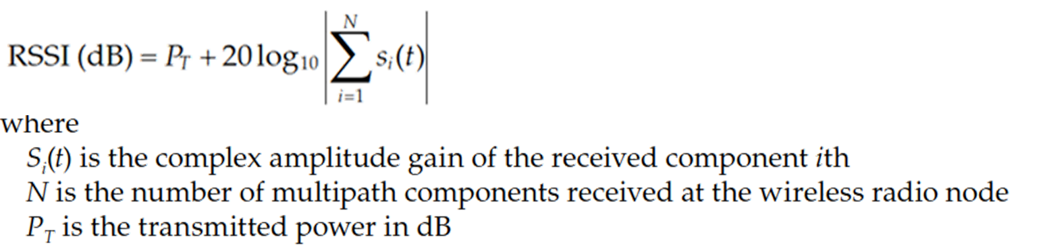
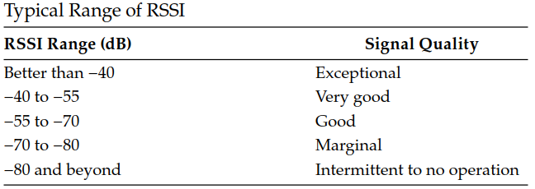
Sensor Networks and Associated Technologies for CPS Applications (Contd.)
Wireless Networks as Sensor Networks
For a narrowband receiver, the RSSI in dB (decibel) of a wireless radio node can be expressed mathematically as:

Slide 34
Sensor Networks and Associated Technologies for CPS Applications (Contd.)
Smart Sensor Networks
A Smart Sensor Network (SSN) consists of a network of smart sensors that are connected through a wireless network, and the network is designed to meet a specific application, such as smart home or smart city or intelligent building, etc.
A typical system architecture for an SSN is presented in Figure
The wireless sensor networking nodes presented in this gure are assumed to use low power devices that meet IEEE 802.15.4 standard, which denes various layers for interconnecting these sensor nodes
The Operating System (OS) employed by SSN is the TinyOS operating system, which is a small core, multitasking
TinyOS was developed by the University of California and used the NesC language.
The remote management and visualization system includes but is not limited to 4G Android or/and Personal Computer (PC) or/and Ipad with the smart sensor process
SSN has been used by emerging CPS, such as intelligent health-care cyber system and intelligent transportation cyber system

Slide 35
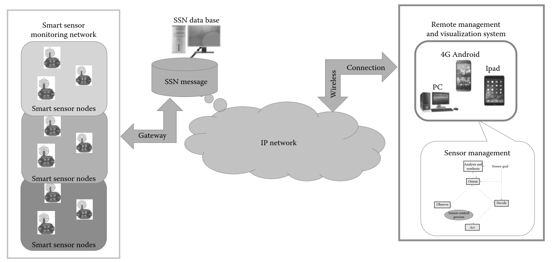
Sensor Networks and Associated Technologies for CPS Applications (Contd.)
Smart Sensor Networks
Figure. Typical SSN System Architecture

Slide 36
Sensor Networks and Associated Technologies for CPS Applications (Contd.)
Ubiquitous Sensor Networks for Internet of Things (IoT)
The term “Ubiquitous Sensor Network” or USN is a network of intelligent sensors that are available “anywhere, anytime, by anyone and anything.”
USN is also referred to as “invisible,” “pervasive” or “ubiquitous” computing or to describe “Internet of Things” or IoT. The network consists of three key elements including sensors, tags, and communication/processing capacity
By 2020, Gartner predicts that IoT would be made up of 26 billion “units”
IoT is the Networks of Sensors (NoSs) that are used by people through “Process,” “Data,” and “Things.”
It has also defined the “Process” as an approach to deliver the right information to the right person, and “Things” as the physical devices and object connected to the Internet and each other for intelligence decision making (1) operational technologies, (2) networks, “Fog” computing, storage, (3) data analysis, and (4) control system.
The “Connectivity” includes data center and networks. “Fog” computing is dened as a computing layer to make simple determination of what information is needed for the mission.

Slide 37
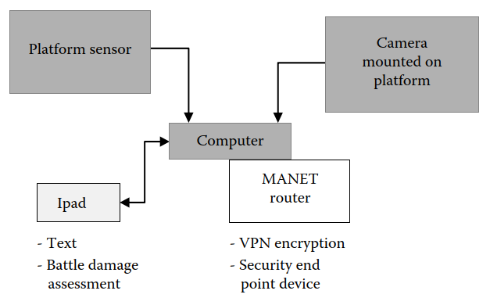
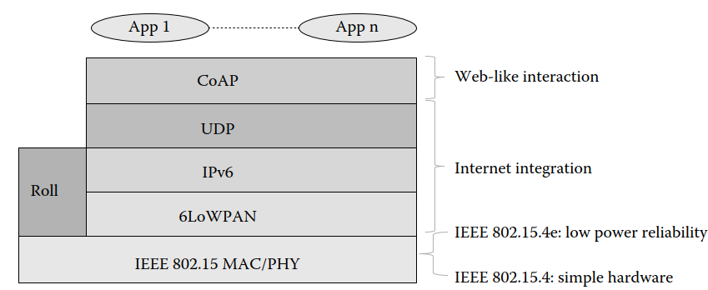
Sensor Networks and Associated Technologies for CPS Applications (Contd.)
Ubiquitous Sensor Networks for Internet of Things (IoT)
Figure. Example of CISCO Mobile Ready net.
Figure. Recommended standard IoT Protocol Stack

Slide 38
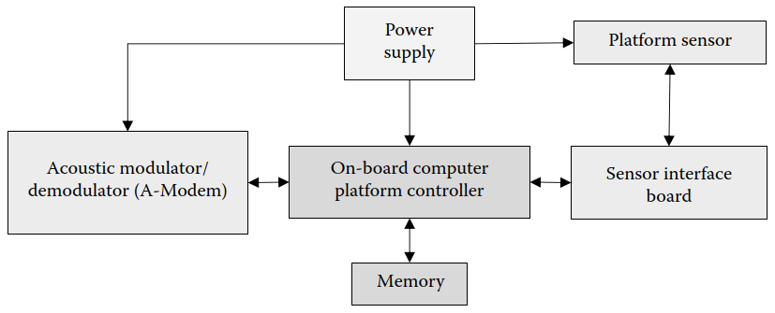
Sensor Networks and Associated Technologies for CPS Applications (Contd.)
Underwater Sensor Network
Underwater Sensor Network (UnSN) is also referred to as Underwater Acoustic Sensor Network (UW-ASN), which consists of a number of fixed sensor nodes and mobile sensor nodes deployed underwater
The data links use to connect these fixed and mobile sensor nodes employ acoustic wireless communications
A typical underwater sensor system architecture using acoustic wireless communications is shown in Figure

Slide 39
Sensor Networks and Associated Technologies for CPS Applications (Contd.)
Underwater Sensor Network
The platform sensor can be placed in a fixed or mobile platform with an on-board computer that serves as the platform sensor controller providing sensor and communication resources management
The controller provides self-configuration of the network of underwater sensor nodes and adapts to harsh ocean environment. The Acoustic Modulator/Demodulator (A-Modem) connects the sensor nodes using underwater sensor network protocol
The four protocols employed by the existing A-Modem are flooding-based, multipath-based, cluster-based, and miscellaneous-based routing protocols
The power supply is a limited battery, which cannot be replaced or recharged. The issue of energy conservation for UW-ASN is currently evolving to more power efcient underwater communication and networking techniques
Applications of UW-ASN include scientific, Industrial, Military, and homeland security applications

